Slide 1
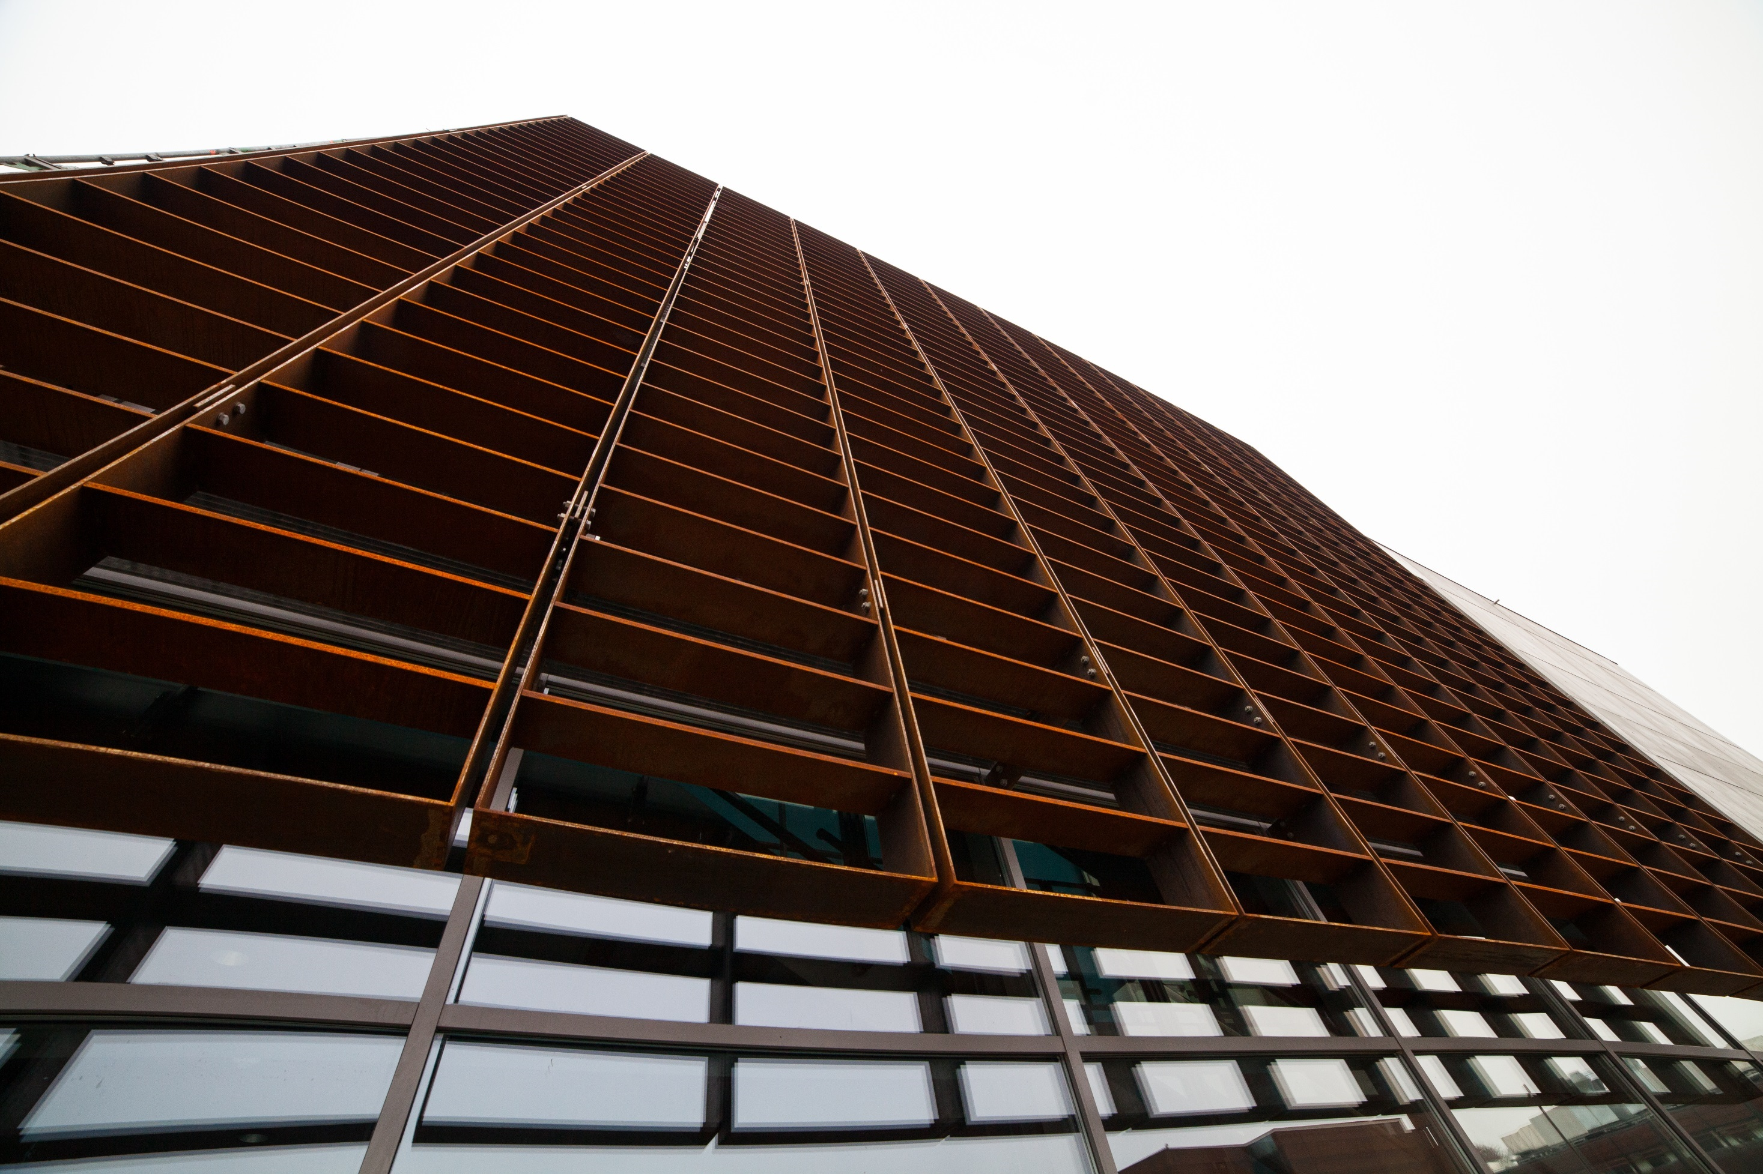

Center for Energy Informatics
Research – Development – Innovation
Krzysztof Arendt, Konstantin Filonenko and Christian Veje

Slide 2
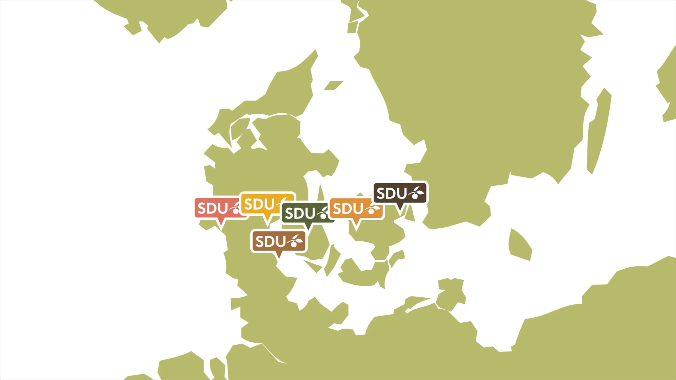
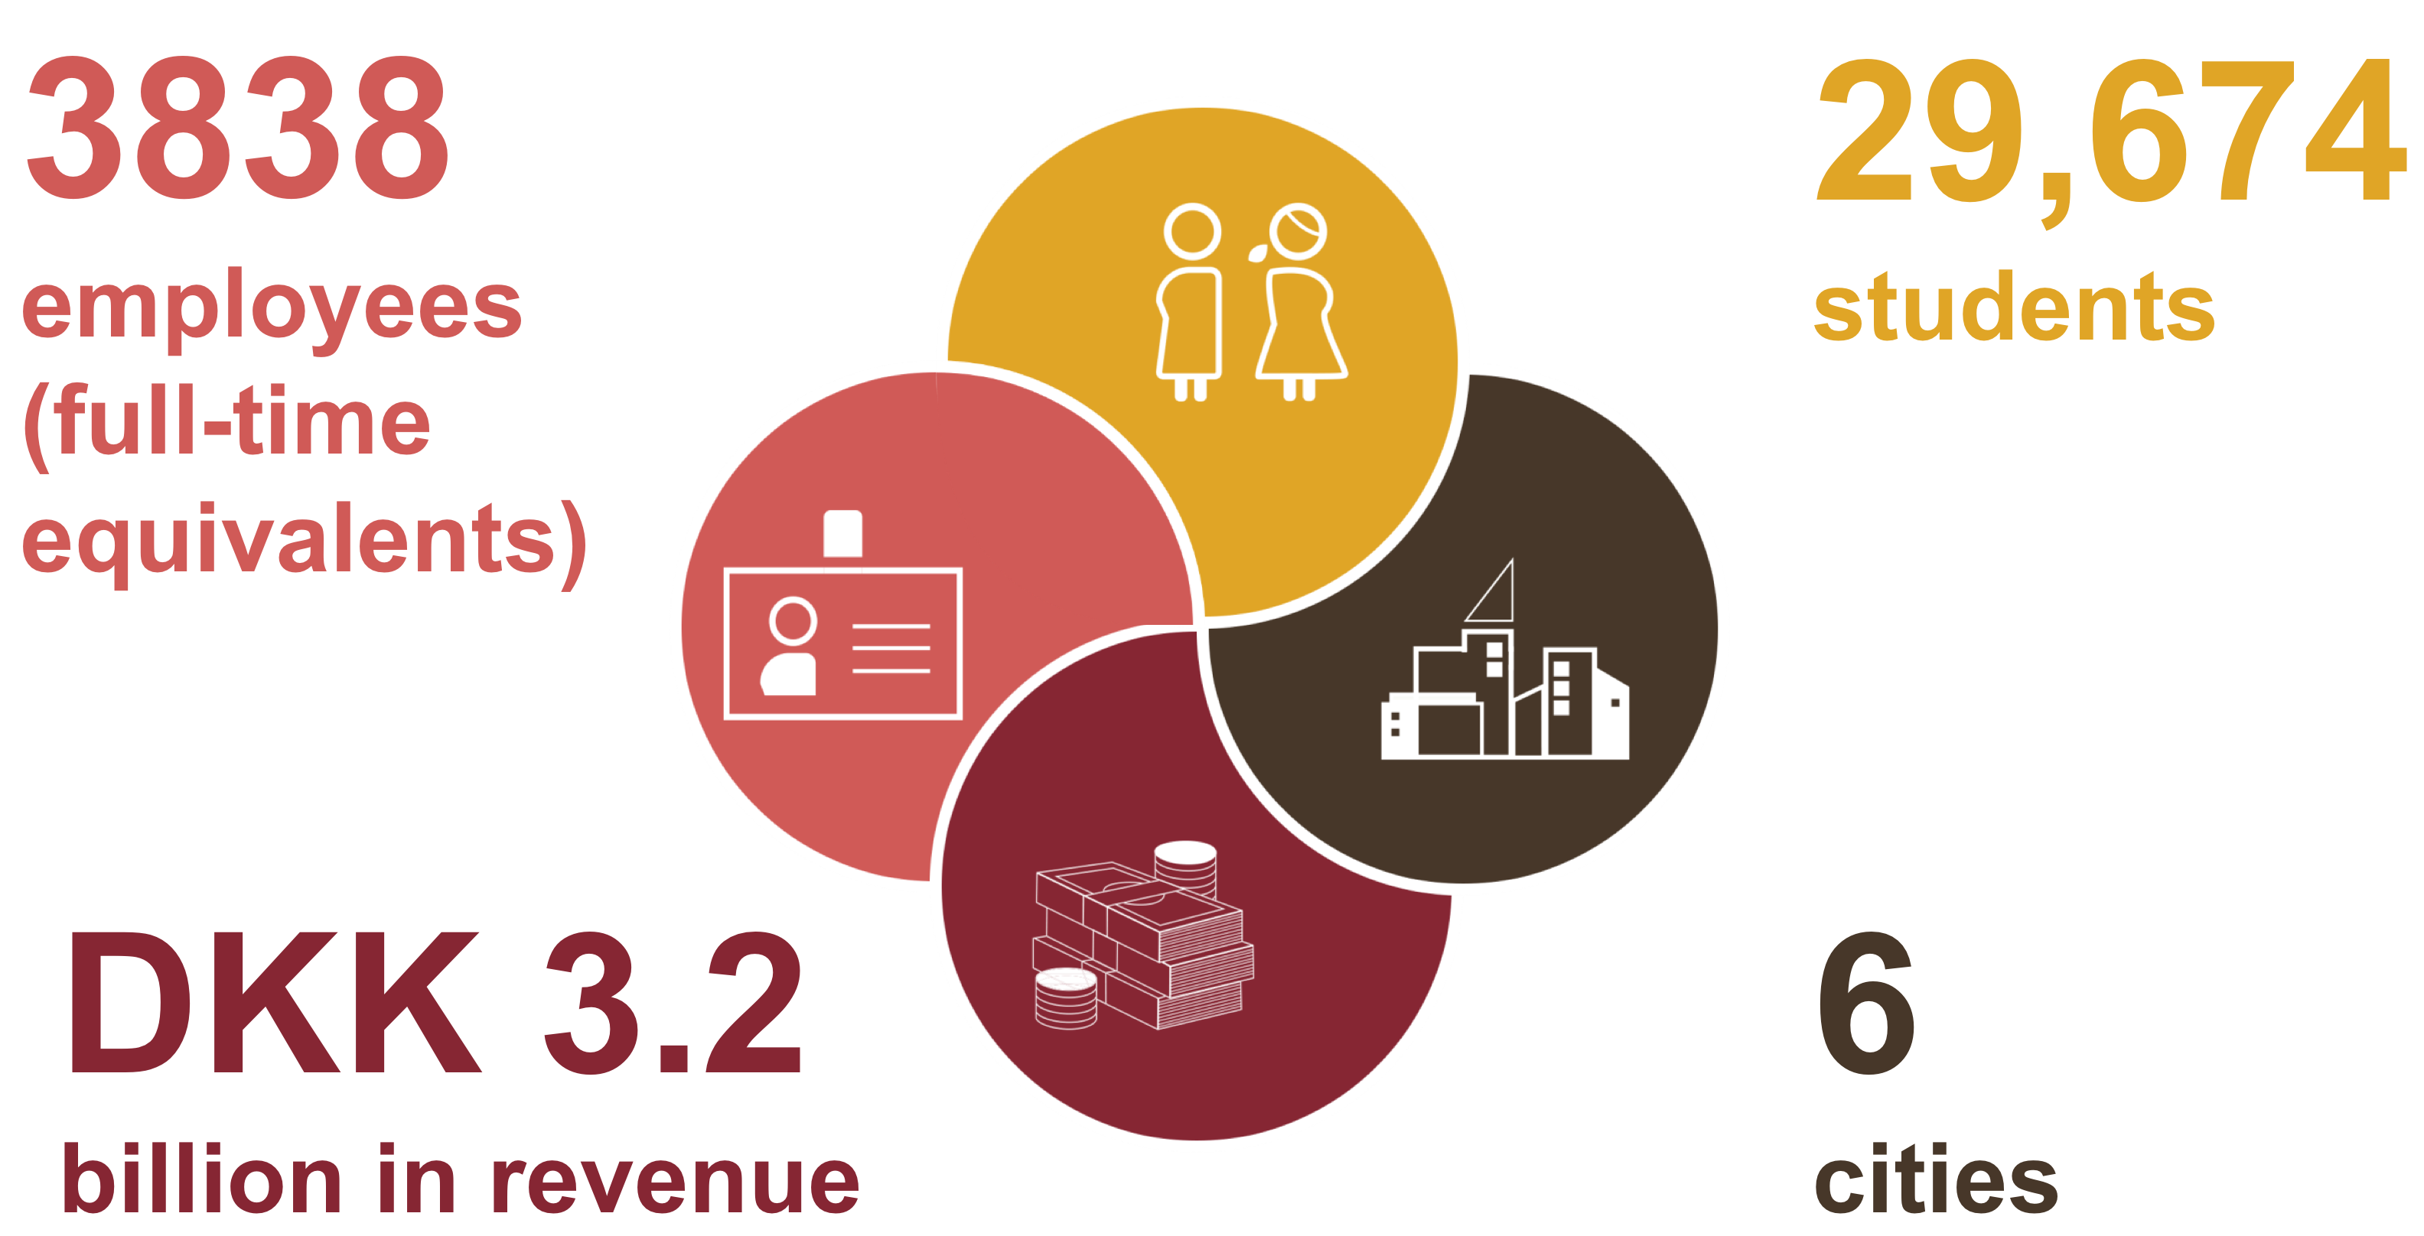
Faculties+cities overview
University of Southern Denmark

Slide 3
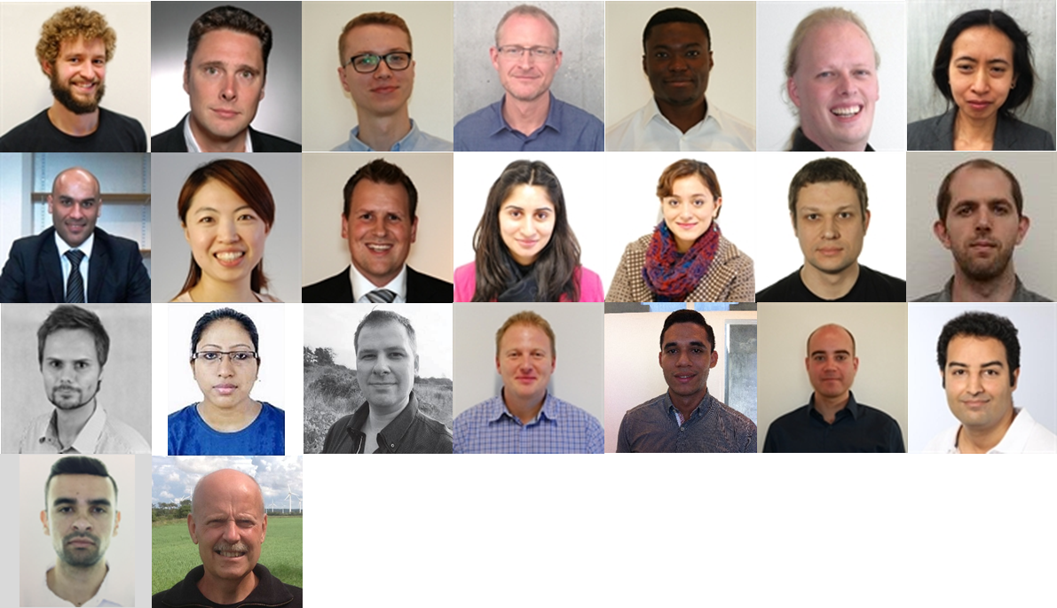
Center staff
6 Associate Professors
2 Assistant Professors
1 Honorary Associate Professor
4 Post Docs
7 PhD students
1 Research Assistant
2 Professor WSR
Interdisciplinary center
Software Engineers
Computer Scientists
Applied Physicists
Control Engineers
Social Scientists
Krzysztof Arendt
Konstantin Filonenko
Christian Veje

Slide 4
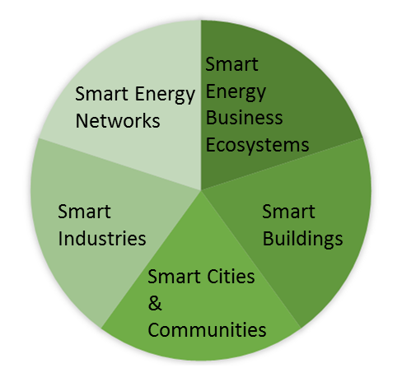
Research areas
Developing ICT-centred solutions for increasing the intelligent use of energy within five interconnected themes
www.sdu.dk/energyinformatics

Slide 5





Smart Buildings
ICT- solutions that improve the energy performance of new and existing buildings and enable buildings to contribute with flexible consumption to the grid
Smart Energy Networks
Smart Energy Business Ecosystems
Smart Industries
Smart Buildings
Present research projects:
Smart Cities and communities
IEA EBC Annex 66

Slide 6

Smart Energy Networks
Smart Energy Networks
The research focus on developing ICT-centred solutions for coordinating the supply and demand in environmentally sustainable energy networks, including; electricity, gas, district heating and cooling.
Smart Energy Business Ecosystems
Smart Industries
Smart Buildings
Smart Cities and communities
Towards the Thermal Grid

Slide 7
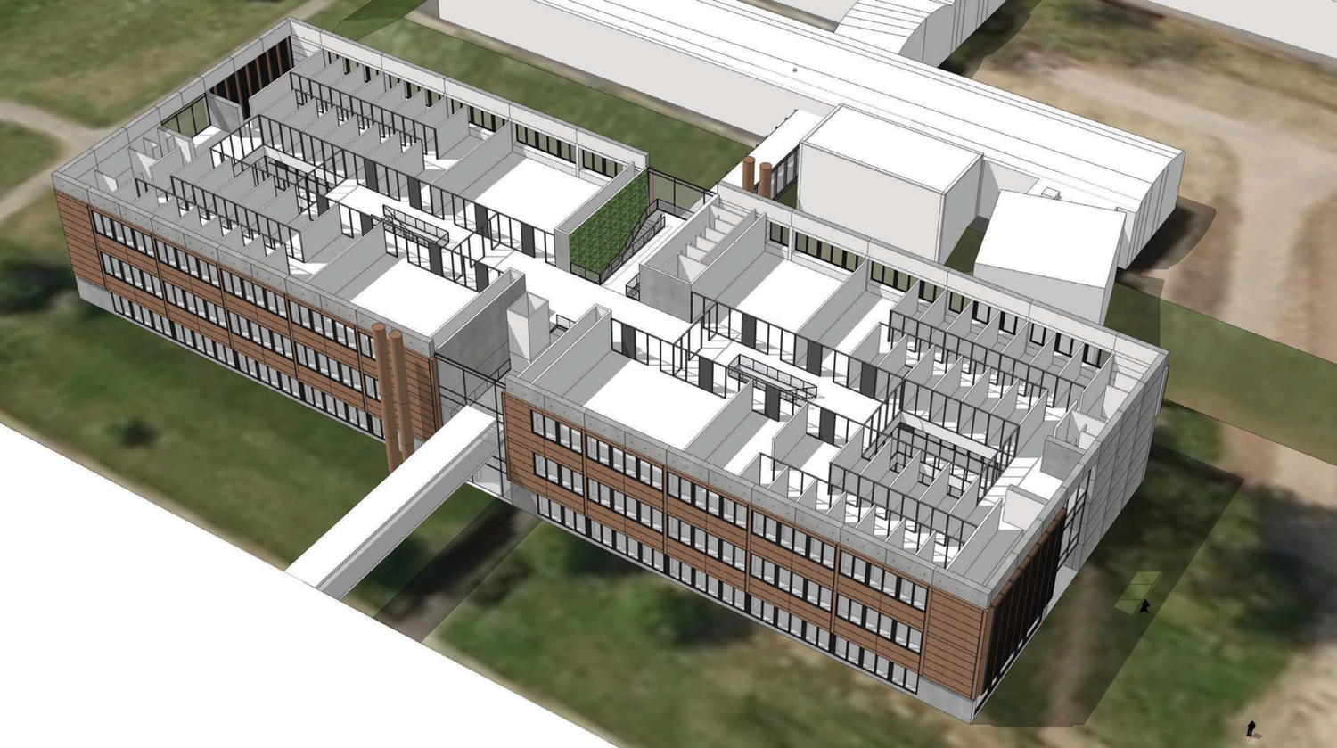
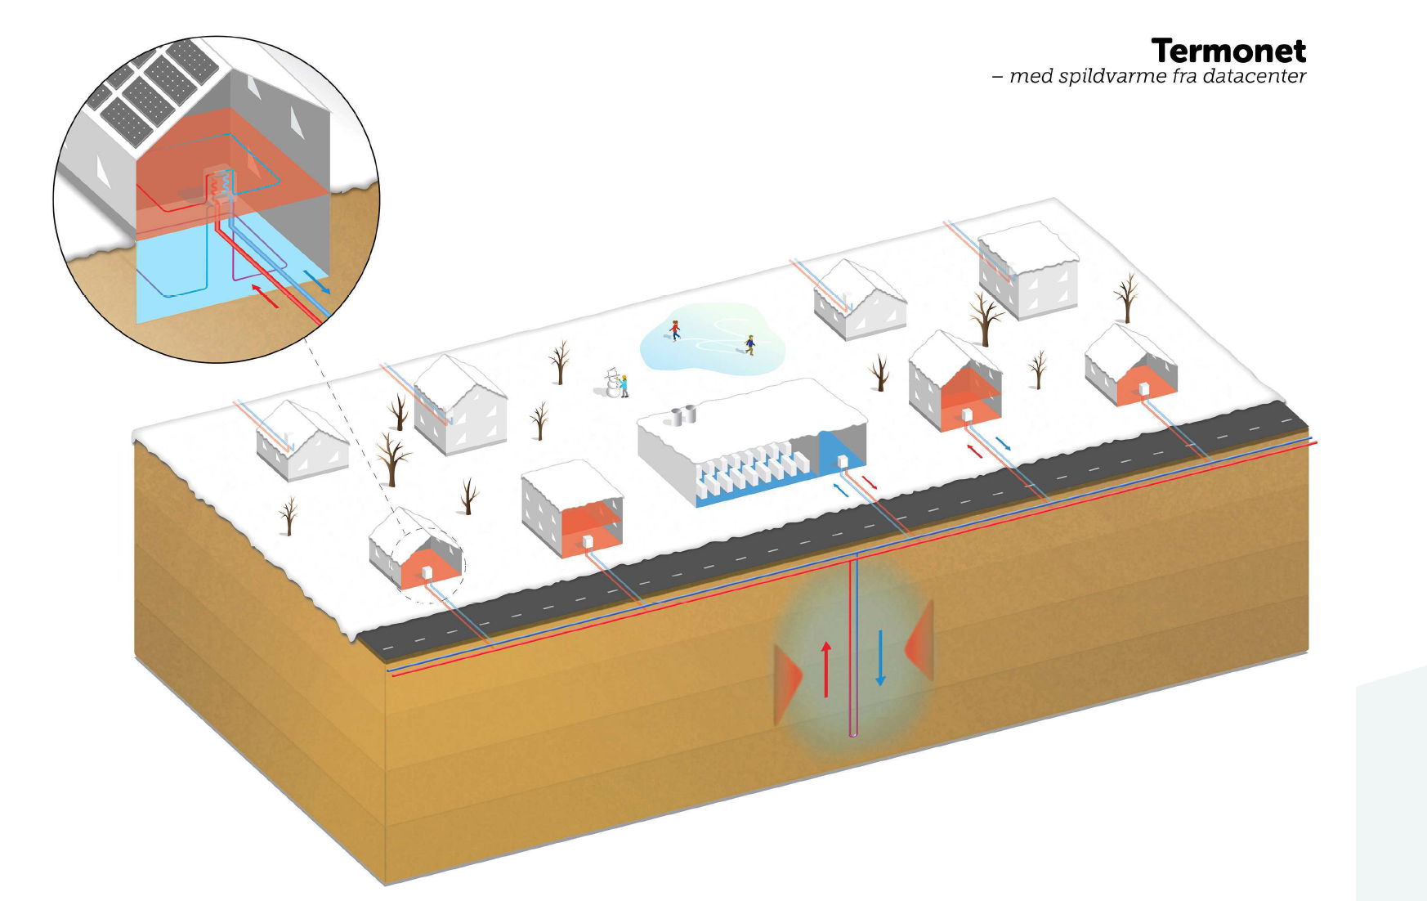
IBPSA Project 1 participation
Smart Buildings Modelica based zone modeling for – GA based MPC (and alternatives!) Virtual and physical case study building(s)
Smart Energy Networks Modelica based DH&C local network (Ground source HP based network) for – design and operation Real system case study
WP1.2 MPC, Buildings Lib (Krzysztof Arendt)
WP3 Applications Buildings Lib IDEAS (Konstantin Filonenko)

